Slide 1
The Power of Symmetry
By Ruben Fuguett-Gutierrez

Slide 2
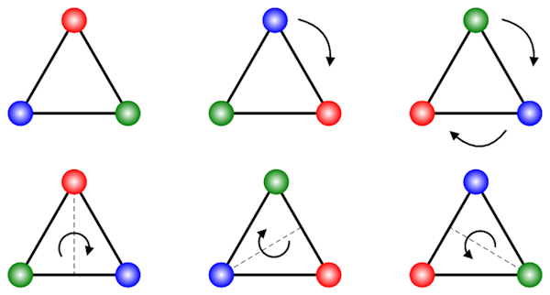
Triangle Transformations
6 elements in the group
Forms the Dihedral group D₃ of order 6
Two types of symmetry (rotation and reflection)
3 sided shape
Notes:
Pull out triangle shape
Here I have an equilateral triangle. Now there's lots of things I can do with this triangle, but I only care about 2 things I can do with it. Rotating it and reflecting it so that it looks the same in space. How many ways are there to do this? Well technically you could rotate it a bunch of times but that would be no fun, there are 6 main ways you could rotate it or flip it to make it look exactly the same in space. Show the ways on screen
You can do nothing to it, rotate it by 120 or 240 degrees and you can also flip it on its three lines of symmetry. These transformations are an example of a more fundamental structure. Together they form a mathematical structure called a group.

Slide 3

Noether's theorem
Every symmetry of a physical system has a corresponding conservation law
Symmetry of time leads to conservation of energy.
Notes:
This idea , that transformations which leave something unchanged form a special structure, turns out to be incredibly powerful for defining the laws of physics. This is formalised by Noether’s theorem which states that a system with an underlying symmetry has a corresponding law of conservation. An example of this comes from the symmetry of time. We can all agree that the laws of physics don't change spontaneously from one moment to another. They are symmetrical throughout time and the consequence of this is that energy is a conserved quantity of the universe

Slide 4
But what is a group?
A group has 4 properties:
Associativity - a*(b*c) = (a*b)*c
Closure - a*b = d where d is also an element in the group
Identity - a*e =e*a = a where e is the identity
Inverses - a*b = e where a and b are inverses
Notes:
Alright that's nice but hold on, what exactly is a group? It seems like a very general term. Well in maths a group has 4 main properties, although certain types of groups have more properties. The four properties are as follow: Put on screen the properties
-Associativity, as long as the order of elements stay the same, it doesn't matter which operation you perform first. (a+b)+c will always be equal to a+(b+c).
-Closure, meaning when you perform an operation with two elements of a group, the product will also be in the group, it cannot be outside of it. For example if you were to perform division on whole numbers, this would not form a group as you can get decimal answers, violating the closure property
-Identity, we have dealt with identities since primary school, for addition the identity is 0 as nothing happens when we add 0 to a number, for multiplication it is 1. You can get wackier identities depending on the type of group being formed but they generally act the same way
-and lastly, inverses. Every element in a group needs to have an inverse which gives back the identity. Lets stick with the example of addition again, adding the negative of a number to itself gives you the identity, 0. So the inverse of any element is the negative of itself. That was a lot to take in for such a short time, so just think about the consequences of each property. Pause briefly

Slide 5
Rotating larger sided shapes
No matter what rotation you perform the circle will stay the same (invariant)
Notes:
Lets briefly think about the triangle again now, you have to rotate it by 120 degrees or 240 degrees to make it look the same. But what if you want to rotate a shape by more angles and have it stay the same? You could use a shape with more sides like a pentagon, or a decagon. Now if we keep adding more sides to this shape we get a circle, where we can rotate it by any angle and have it stay the same.

Slide 6
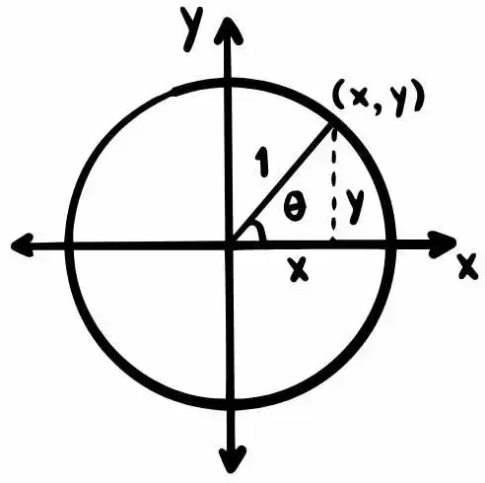
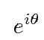
Representing rotations of the circle mathematically
A unit circle with radius of 1
This is used to represent the infinite group of rotations U(1)
x = cosፀ
y = sinፀ
r
r
Too many variables in the equation. Not useful for calculations
You can represent the rotations with polar form instead.
Notes:
These rotations can be traced on a diagram using a unit circle, where the radius from the centre is always 1. The x coordinate of this circle will be equal to the cosine of the angle while the y axis is equal to the sin of the angle. However, working with 2 variables has its disadvantages as it is very awkward to use in calculations. Instead, we can represent it using polar form where we only talk in terms of the angle which is this symbol theta. The derivation for this is beyond the scope of what is necessary. All we care about is that this represents a rotation on a unit circle. This arbitrary rotation is what composes a very useful group U(1). 1 referring to one dimension of rotation.

Slide 7
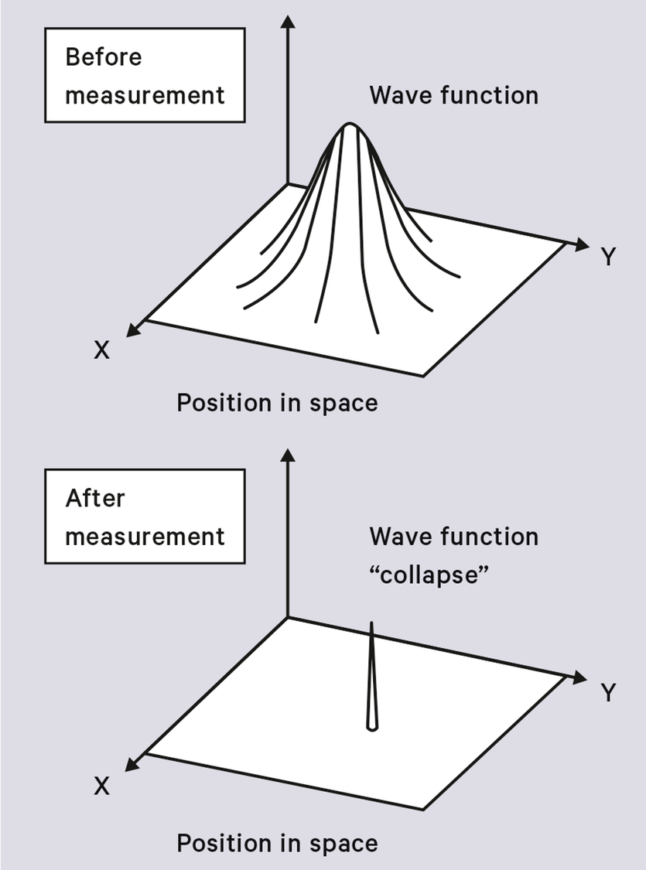

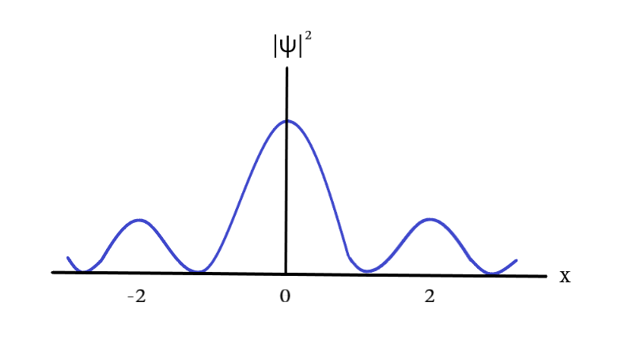
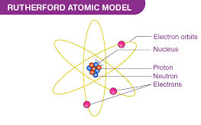

Electrons
Representation of a wave function in 1 dimension of space.
Representation in 2D. Before and after the electron is observed
The greek symbol Ψ (psi) is used to represent the wave function / probability of where a particle will be found.
Notes:
So what can the U(1) group do? To truly see its power we have to talk about the physics of small stuff, specifically electrons. Now you may have come across Rutherford's atomic model. The model is good, but it is not a very accurate representation of how electrons actually behave. When we talk about electrons on a small scale, they are not said to be in a specific position in space. Instead they have a probability of being observed somewhere in a region of space Put 1d. Each point in space will have a likelihood of the electron being observed at that point. A wave function expresses where the electron is likely to be found. Here are one and two dimensional representations of where the electron can be. The height of the graphs shows how likely it is to be observed at the point below it.

Slide 8
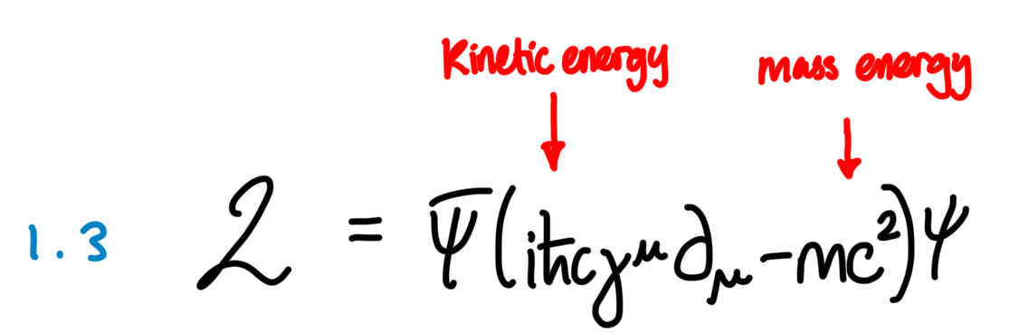
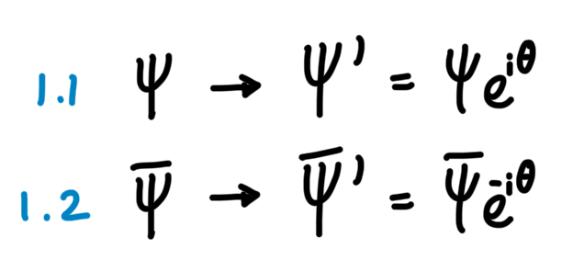
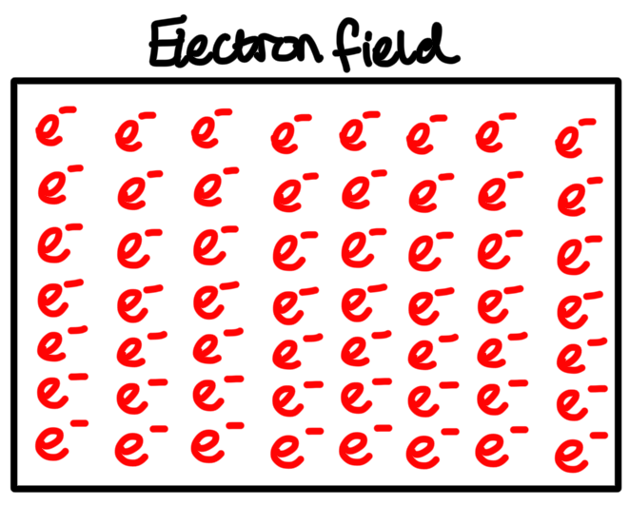
Wave function transformations
Description of the electron’s energy
Electrons have an intrinsic spin to them, when you apply a U(1) transform to the wave function, you change the orientation of the spin.
If the energy equation is applied to the electron field, we can see the effects of performing a U(1) transformation
Notes:
Now, we can apply a rotation to the wave function of the electrons using the U(1) group. This changes the direction of spin of the electron and gives a new, transformed wavefunction. We can relate this to Noether’s theorem and see if the particle's energy is conserved or not when we do different types of rotations. The energy is expressed as the difference between the electron’s kinetic energy (related to how fast it's going) and it’s mass energy (related to how much mass it has). We can use this equation to see if the energy of the particle is affected or not. To do this, we can apply the equation to a hypothetical system with electrons at every single point and see what happens. This is called a field transformation

Slide 9
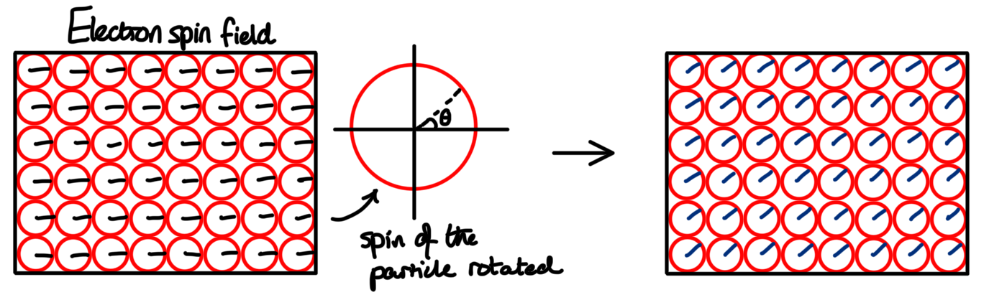
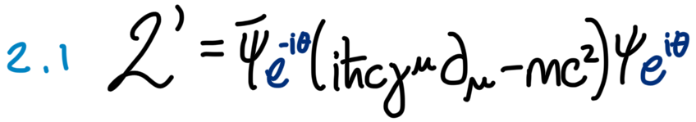
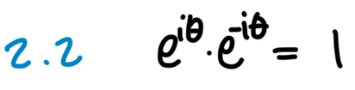
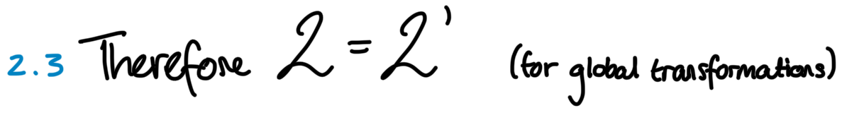
Global Transformations
The rotation of the wave function is cancelled out so the symmetry of energy before and after the global transformation is upheld
Notes:
If we rotate every single electron by the same amount, the energy of the system will be conserved as there is no relative change in spin throughout the system. This is known as a global transformation. If we take a look at the energy equation, it looks the same as it is invariant under global transformations. There is a conservation of energy, showing a symmetry before and after the transformation.

Slide 10
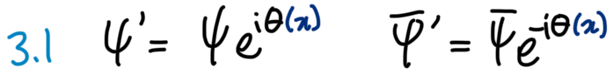
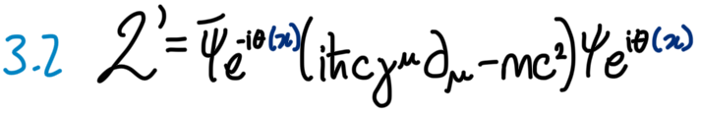
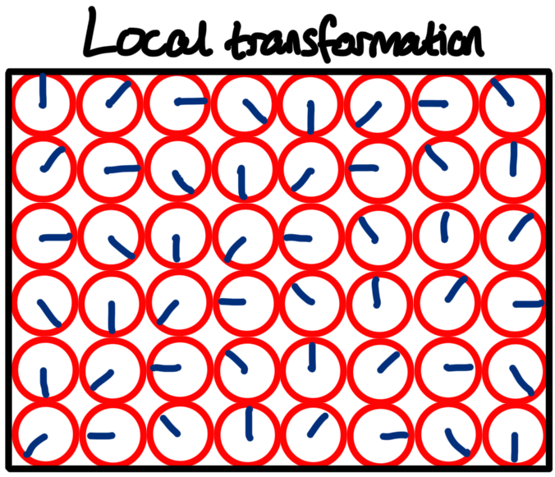

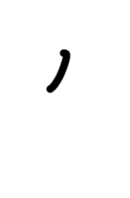
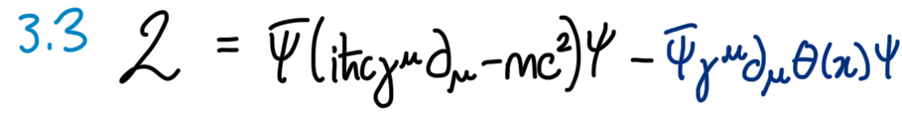
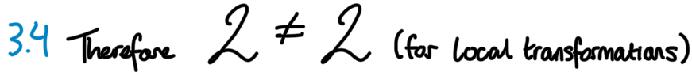
Local Transformations
What if we want to choose how much we rotate each electron?
We can define a function by which we will rotate the electrons. This is what it means to apply a Local transformation
Substitute the rotation into the energy equation
Applying the rotation leads to this
Extra Term (not good at all)
Notes:
But what if we want to choose how much we rotate each electron individually?We can define a function by which we will rotate the electrons. This is what it means to apply a Local transformation. Well now the rotation is a function affected by position and we can apply this to the energy equation. Buut it turns out that this does not play well with the equation. We no longer have invariance in the system as we picked up an extra term. This is not good at all since we wont have a conservation of energy anymore so there is no symmetry.

Slide 11

No symmetry…
Great, let's call it a day there. There’s nothing we can do. Thanks for coming to my talk :)
Is what a loser would say… but we can still make the energy have symmetry!
Notes:
So i guess this was all pointless. I wanted to show the power of symmetry but it looks like theres nothing symmetrical about this. So lets call it a day here, thanks for coming to my talk. Is what a loooooser would say, but we can actually still make the symmetry happen.

Slide 12
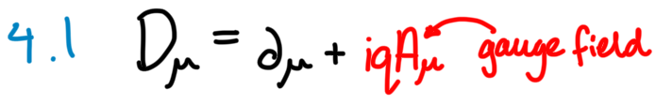
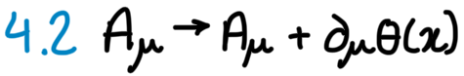
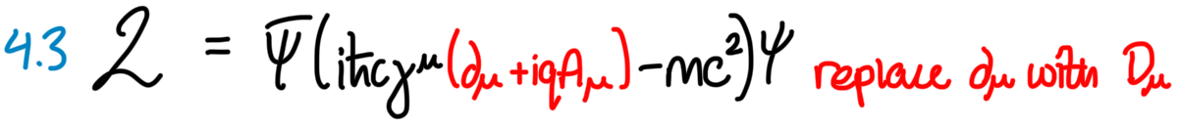
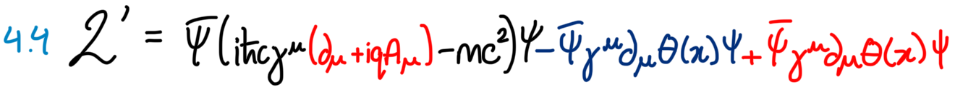
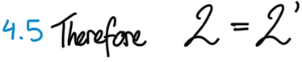
How do we regain the symmetry?
Add A gauge field! (Force mediator)
Transformation of the gauge field results in an extra term
Improved energy equation
These terms cancel out! So equation is now invariant
Notes:
So how do we regain the symmetry ? Well we can add something called a gauge field, a force mediator that - when transformed - cleans up the leftover terms from before.Well that's great! But it just looks like mathematical trickery. What could possibly be represented by this term that we are adding?

Slide 13

What did we add to the equation?
We just added a photon field to the equation!!!
We just added a photon field to the equation!!!
We just added a photon field to the equation!!!
We just added a photon field to the equation!!!
We just added a photon field to the equation!!!
We just added a photon field to the equation!!!
We just added a photon field to the equation!!!
Local U(1) symmetry allowed us to derive the electromagnetic force. This is the TRUE power of symmetry
Notes:
As it happens to be,we just added photons to the equation. The particle that carries light and mediates the electromagnetic force. Local U(1) symmetry allowed us to derive the electromagnetic force! It truly is remarkable, just by demanding a symmetry from the equation, we can derive an entire fundamental force. This is the true power of symmetry. It can be used to build the tools that describe our reality

Slide 14

Let that sink in
Notes:
Let that sink in , just think about it for a bit

Slide 15
Doing a similar process with other groups
Electromagnetic Force - Contributes to atom formation and all of chemistry, in result allowing for life to exist.
U(1) - 1 dimension of rotation. Gives rise to 1 force carrier (Photon)
Weak Nuclear Force - Allows particle decay to occur. Without it the Sun’s fusion would cease.
SU(2) - 3 dimensions of rotation. Gives rise to 3 force carriers (W⁺,W⁻,Z⁰)
Strong Nuclear Force - Allows atomic nuclei to exist. Without it, the universe would have no elements. Just free particles.
SU(3) - 8 dimensions of rotation. Gives rise to 8 force carriers (Different flavoured gluons)
Notes:
This can be done with similar groups aswell. The electromagnetic force we have already talked about. It is formed by using a gauge theory for U(1). The weak force is formed by using a gauge theory for SU(2). The strong force is formed by using a gauge theory for SU(3). Together, these groups compose the standard model of physics, which is the best representation of reality we have to this day.

Slide 16
The Power of Symmetry
By Ruben Fuguett-Gutierrez
Notes:
The triangle had 6 symmetries. A circle has infinitely many. When you plant the seed of this infinite symmetry into quantum mechanics, what grows out of it becomes the very structure that gives rise to everything we see. From the universe itself, to the atoms that make it up, and life as we know it. All of it, is thanks to the power of symmetry

